Slide 1
Predicting hospital Readmissions
Trevor Maxwell
DSC530

Slide 2
Data & variables
age
age range of the patient
time_in_hospital
in days, duration of the patient stay
n_procedures
number of procedures performed during the hospital stay
medical intervention that remedies injury or illness
can be surgical or non-surgical
n_lab_procedures
number of laboratory procedures performed during the hospital stay
n_medications
number of medications administered during the day
n_outpatient
number of outpatient visits in the year before a hospital stay
n_inpatient
number of inpatient visits in the year before a hospital stay
n_emergency
number of visits to the emergency room in the year before the hospital stay
medical_specialty
the specialty of the admitting physician
diag_1
primary diagnosis (Circulatory, Respiratory, Digestive, etc.)
diag_2
secondary diagnosis
diag_3
additional secondary diagnosis
glucose_test
whether the glucose serum came out as high (> 200), normal, or not performed
A1Ctest
whether the A1C level of the patient came out as high (> 7%), normal, or not performed
change
whether there was a change in the diabetes medication ('yes' or 'no')
diabetes_med
whether a diabetes medication was prescribed ('yes' or 'no')
readmitted
if the patient was readmitted at the hospital ('yes' or 'no')
The data contains many variables both categorical and numerical (listed to the right). The numerical variables are used in the analysis. These variables are:
Time in hospital
Number of procedures performed
Number of lab procedures performed
Number of medications administered during the hospital stay
Number of outpatient visits in the year before the hospital stay
Number of inpatient visits in the year before the hospital stay
Number of emergency visits in the year before the hospital stay
The response variable to be predicted is readmitted. This variable is whether the patient was readmitted after the hospital visit.

Slide 3
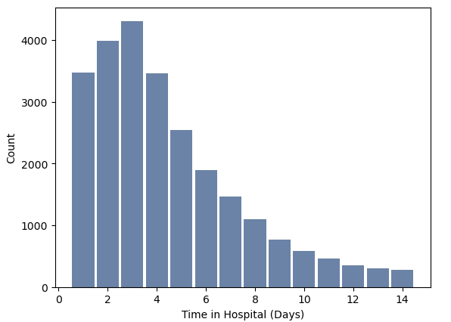
Time in hospital
Mean: 4.45332
Mode: 3
Spread:
Min: 1
25%: 2
50%: 4
75%: 6
Max: 14
Tail: skewed to the right
No outliers were removed.

Slide 4
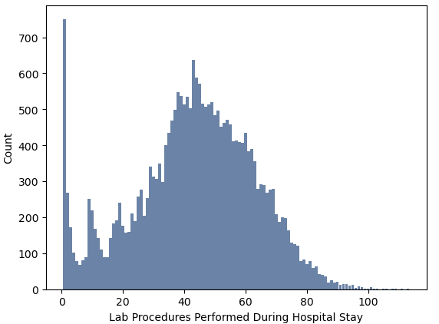
Number of lab procedures
Mean: 43.24076
Mode: 1
Spread:
Min: 1
25%: 31
50%: 44
75%: 57
Max: 113
Tail: Emulates a normal distribution excluding the peak at 1
No outliers were removed.

Slide 5
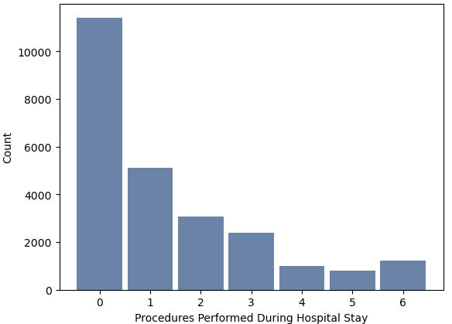
Number of Procedures
Mean: 1.35236
Mode: 0
Spread:
Min: 0
25%: 0
50%: 1
75%: 2
Max: 6
Tail: Skewed to the right
No outliers were removed.

Slide 6
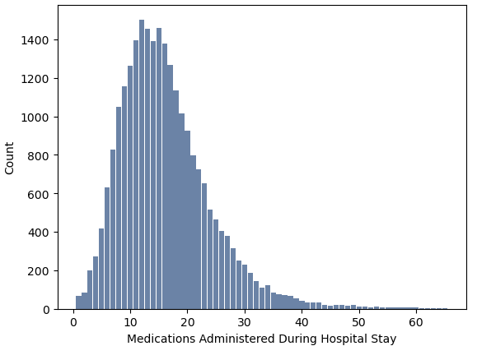
Number of medications administered during the hospital stay
Mean: 16.2288
Mode: 12
Spread:
Min: 1
25%: 11
50%: 15
75%: 20
Max: 65
Tail: Skewed to the right
Outliers greater than 65 were removed. While I believe these are accurate, they were rare events and removed.

Slide 7
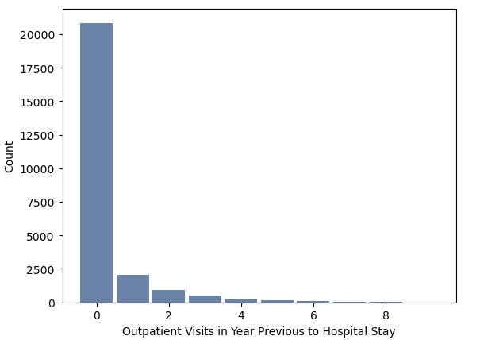
Number of outpatient visits in year before hospital stay
Mean: 0.3299
Mode: 0
Spread:
Min: 0
25%: 0
50%: 0
75%: 0
Max: 8
Tail: Skewed to the right
Outliers greater than 10 were removed. While I believe these are accurate, they were rare events and removed.

Slide 8
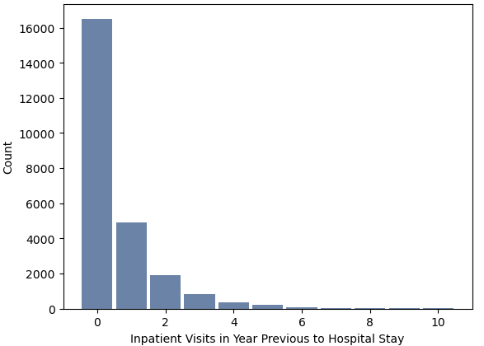
Number of inpatient visits in year before hospital stay
Mean: 0.6037
Mode: 0
Spread:
Min: 0
25%: 0
50%: 0
75%: 1
Max: 10
Tail: Skewed to the right
Outliers greater than 10 were removed. While I believe these are accurate, they were rare events and removed.

Slide 9
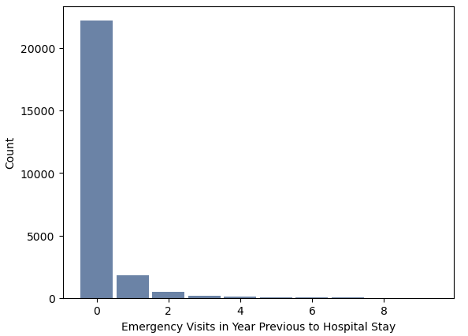
Number of emergency visits in year before hospital stay
Mean: 0.1684
Mode: 0
Spread:
Min: 0
25%: 0
50%: 0
75%: 0
Max: 9
Tail: Skewed to the right
Outliers greater than 10 were removed. While I believe these are accurate, they were rare events and removed.

Slide 10
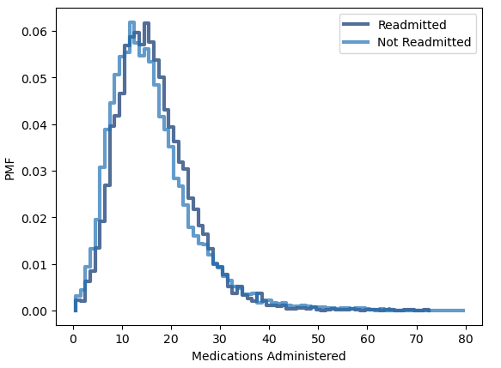
Probability Mass Function for number of medications administered for readmitted vs. non-readmitted patients
As seen in the PMF on the left, patients are less likely to be readmitted when the number of medications are administered is less than around 18 and more likely to be readmitted when medications administered is greater than from around 19 to 35.

Slide 11
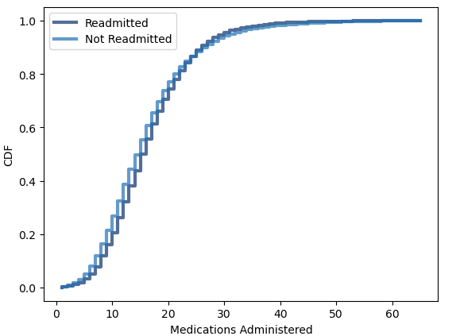
Cumulative Distribution function for number of medications administered
As seen in the CDF on the left, non-readmitted patients generally receive slightly less medications throughout the distribution.

Slide 12
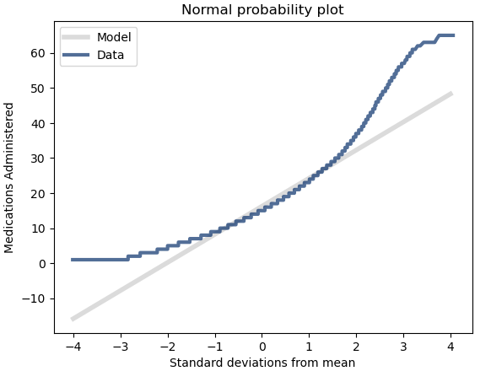
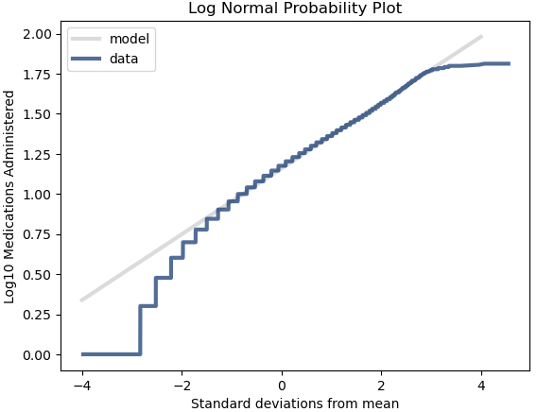
Modeling distributions
The top probability plot is for a normal distribution for medications administered, and the bottom plot is for a lognormal probability plot. The plot deviates at the tails for both probability plots, however the distribution that follows the lognormal distribution significantly better from -1 to 3 standard deviations from the mean.

Slide 13
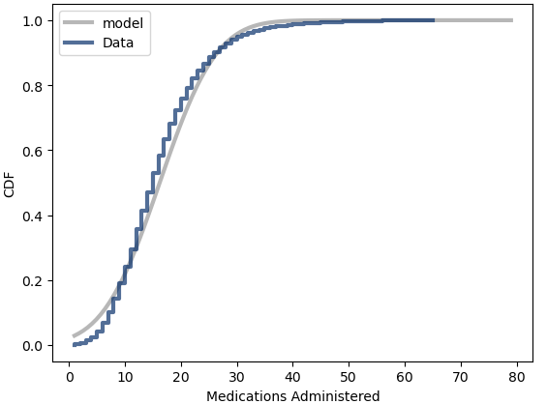
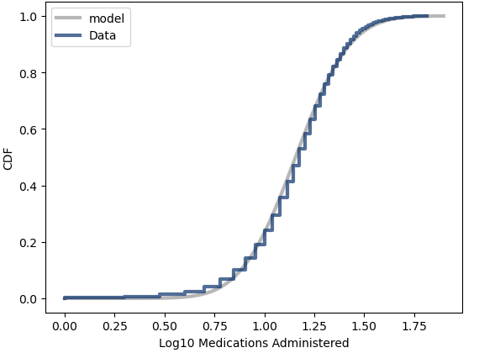
Modeling distributions (cont’d)
Plotting the lognormal (bottom graph) vs. the normal (top graph) CDF indicates that the lognormal plot is a better fit as there is less deviation from the lognormal model throughout the distribution.

Slide 14
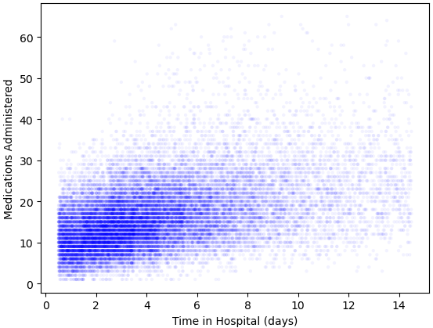
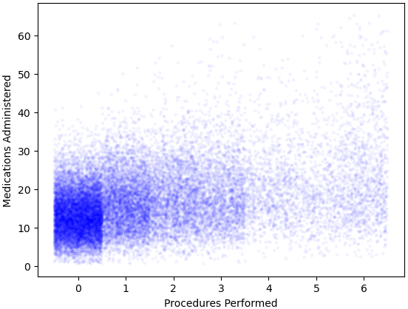
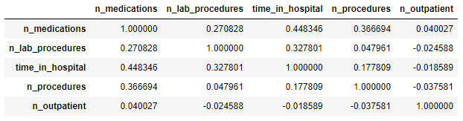
Correlations
As seen in the below table for Pearson’s correlation coefficients amongst the numeric variables, the two highest correlations occur between the number of medications administered vs. time in hospital and medications administered vs. the number of procedures performed.
Medications administered vs. time in hospital
Pearson’s correlation coefficient: 0.448346
Covariance: 10.7787
Moderate correlation
Medications administered vs. procedures performed
Pearson’s correlation coefficient: 0.366694
Covariance: 5.03730
Low to moderate correlation

Slide 15
Hypothesis testing
Two hypothesis tests were performed on the data:
Difference in means test for number of medications administered for patients who were readmitted vs. not readmitted
P value: 0.0
The difference in means between the two populations is statistically significant
Correlation hypothesis test for number of medications administered vs. time spend in the hospital
P value: 0.0
The correlation between medications administered and the time spend in the hospital is statistically significant

Slide 16
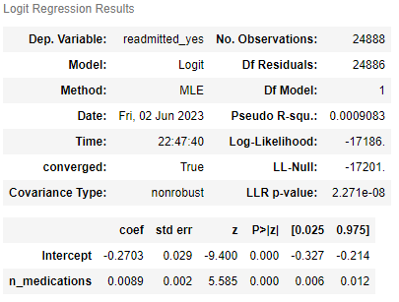
Logistic regression
A logistic regression model was used to observe the effect the number of medications had on the likelihood a patient is to be readmitted to the hospital after the hospital stay.
n_medications coefficient: 0.089
Positive -> each additional medication administered increases the odds the patient will be readmitted
P value: 0.000
Estimated parameter is statistically significant
e^{0.089} = 1.01
For each additional medication administered, the odds of the patient being readmitted increases by 1.01%

Slide 17
conclusion
There are statistically significant differences in the number of medications administered during the hospital stay for readmissions vs. non-readmissions in the distribution.
The p values were less than 0.05
Can be visually observed in the PMFs and CDFs.
Logistic regression model indicated each additional medication administered increased the odds of being readmitted by 1.01%
While its small, it can add up quickly with many medications administered
There is evidence of correlation between the number of medications administered and being readmitted to the hospital.

